Slide 1
STAT 221-FUNDAMENTALS OF STATISTICAL DATA ANALYSIS
Week-4: Frequency Distributions, Cross Tabulation, Data Visualization
Shivakumar Jolad
Associate Professor, FLAME University, Pune

Slide 2
Frequency distributions

Slide 3
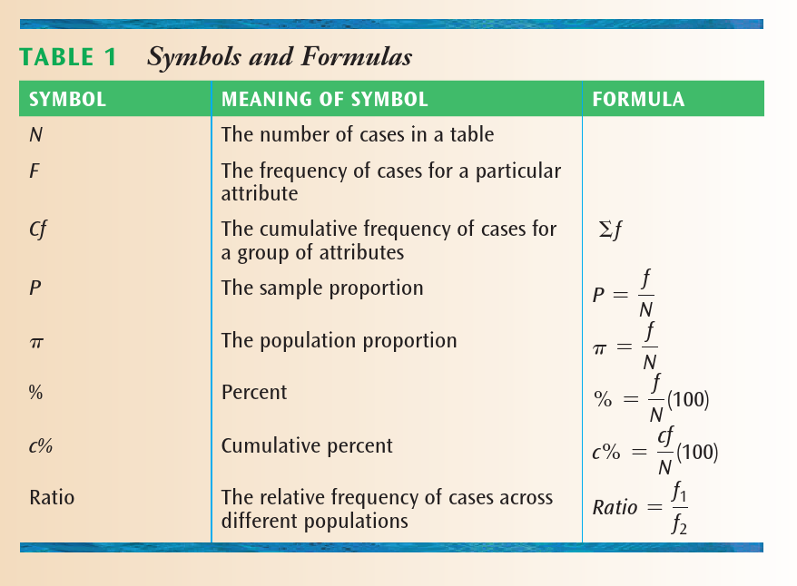
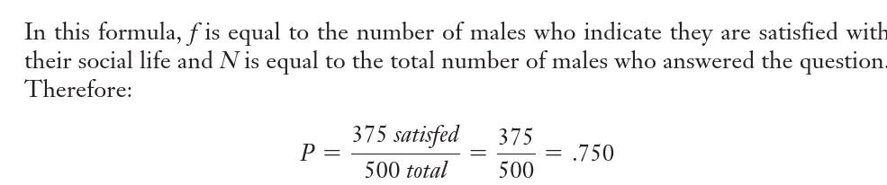

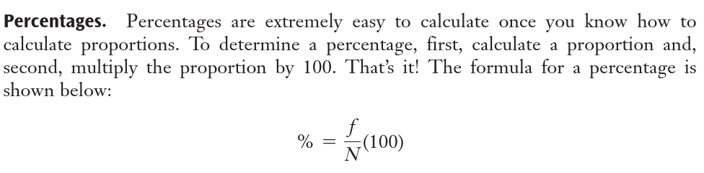
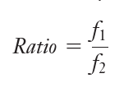
Proportions, Percentages, and Ratios
Proportion: A way to standardize the frequency of cases so that comparisons can be made across populations.
Ratio: A way to compare the relative frequency of cases across populations.

Slide 4
EXERCISE
Suppose we want to know about students’ attitudes toward a ban on tobacco use on campus. We decide to survey 500 students, 355 of whom live on-campus and 145 of whom live off-campus. Of those who live on-campus, 276 indicate that they approve of a tobacco ban and of those who live off-campus, 92 approve of a tobacco ban.
Use this information to answer the following questions.
What proportion of all students approve of a tobacco ban?
What percent of on-campus students approve of a tobacco ban?
What percent of off-campus students approve of a tobacco ban?
What is the ratio of on-campus to off-campus students?
Cross tabulation | Approve tobacco ban | Not approve tobacco ban | Row sum
On Campus | 276 | ? | 355
Off campus | 92 | ? | 145
Column sum | ? | ? | 500

Slide 5
Cross tabulation | Approve tobacco ban | Not approve tobacco ban | Row sum
On Campus | 276 | 79 | 355
Off campus | 92 | 53 | 145
Column sum | 368 | 132 | 500
Cross tabulation (%) ROW PERCENTAGE | Approve tobacco ban | Not approve tobacco ban | Row sum
On Campus | 77.75% | 22.25% | 100
Off campus | 63.44% | 36.55% | 100
Column sum | 73.6% | 26.4%
Interpretation?
Cross tabulation (%) COLUMN PERCENTAGE | Approve tobacco ban | Not approve tobacco ban | Row sum
On Campus | 75.00 | 59.85 | 71.00
Off campus | 25.00 | 40.15 | 29.00
Column sum | 100.00 | 100.00 | 100.00
Interpretation?

Slide 6
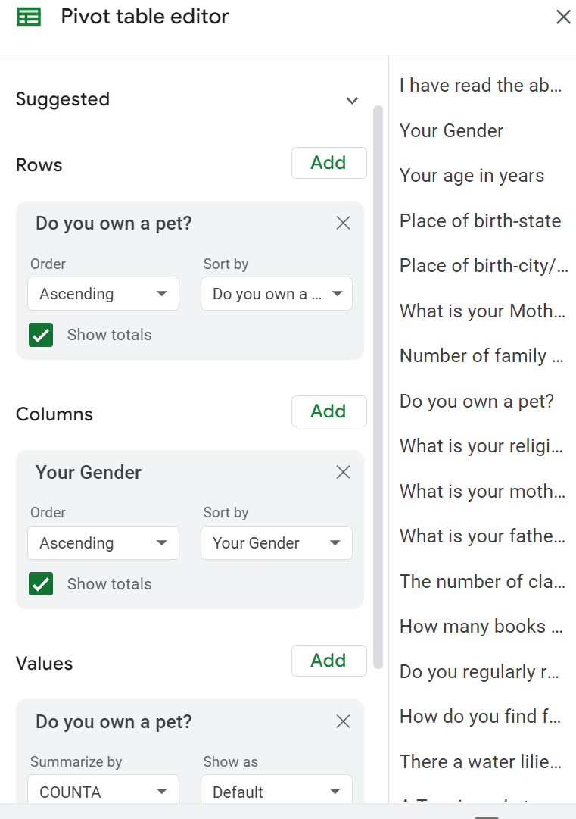
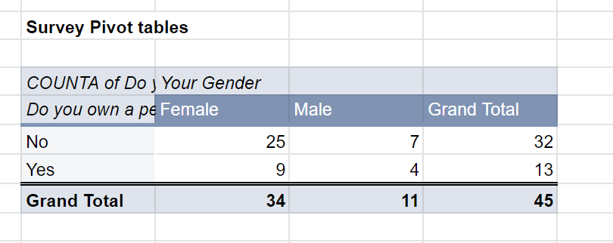
Cross tabulation on excel /Google DOCs
PIVOT TABLES
Do you own a pet? | Female | Male | Overall
No | 73.53 | 63.64 | 71.11
Yes | 26.47 | 36.36 | 28.89
Total | 100.00 | 100.00 | 100.00

Slide 7
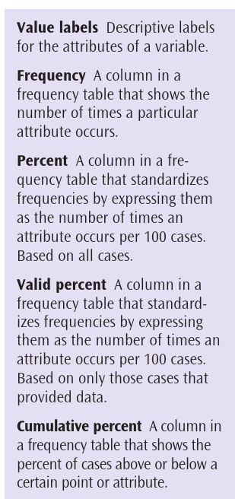
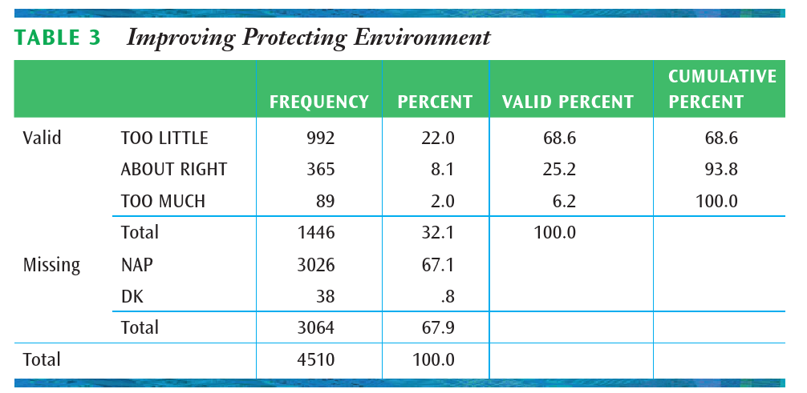
Percentage , valid percentage and cumulative percentage
Missing values: Either the question did not apply to them (NAP) or they did
not provide an answer to the question (DK)

Slide 8
exercise
# | SEX | CLASS STANDING | TIME ON CAMPUS
1 | Male | Freshman | 90
2 | Male | Junior | 75
3 | Female | Junior | 60
4 | Female | Sophomore | 85
5 | Female | Freshman | 95
6 | Male | Senior | 50
7 | Female | Junior | 70
8 | Female | Senior | 60
9 | Male | Sophomore | 90
10 | Female | Junior | 70
Suppose you are doing a study of student integration into social life on campus and want to find out what percent of students live on campus. Using a survey research method, you ask students about their sex, class standing, and what percent of their time they spend on campus. You then test out your questionnaire on a group of stu-
dents in a dining hall and find the following:
Using the data from the test of your questionnaire, construct a frequency table for
the variable Sex. Be sure to include value labels, frequencies, percents, valid percents,
and cumulative percents.

Slide 9
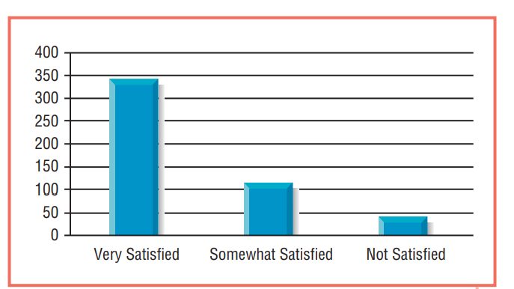
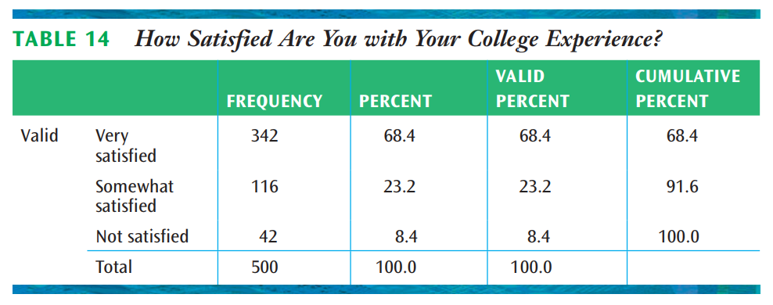
Ordinal variable

Slide 10
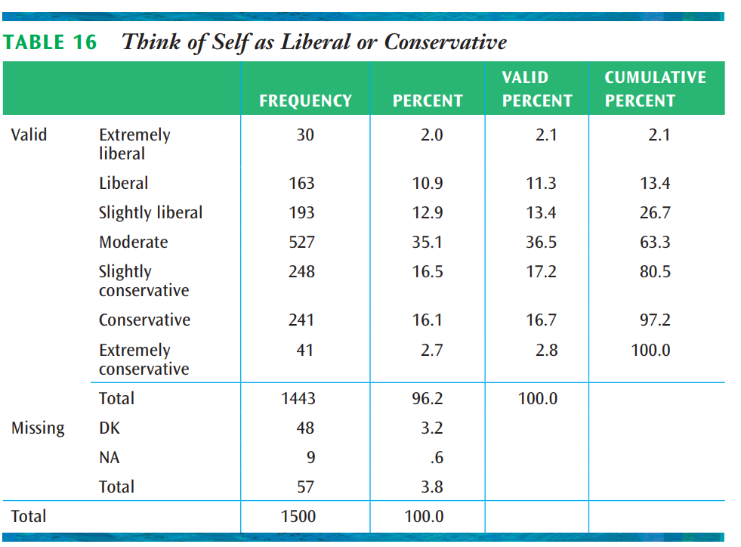
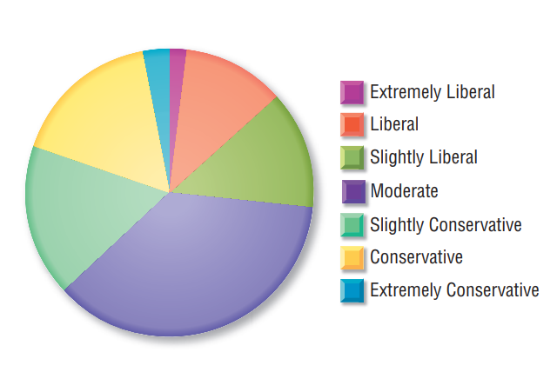

Slide 11

Visual representation of variables

Slide 12
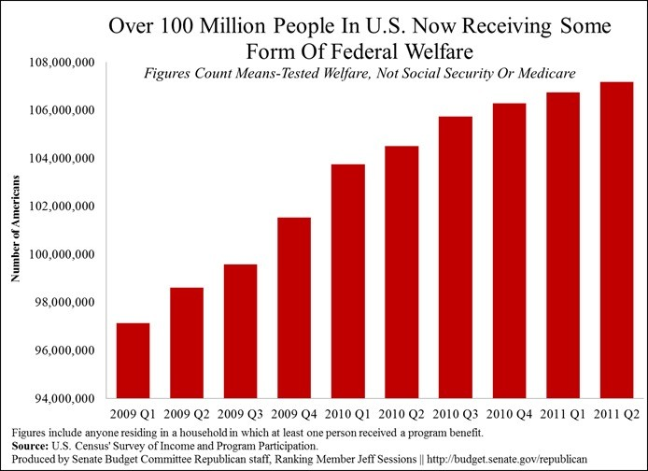
Data deception

Slide 13
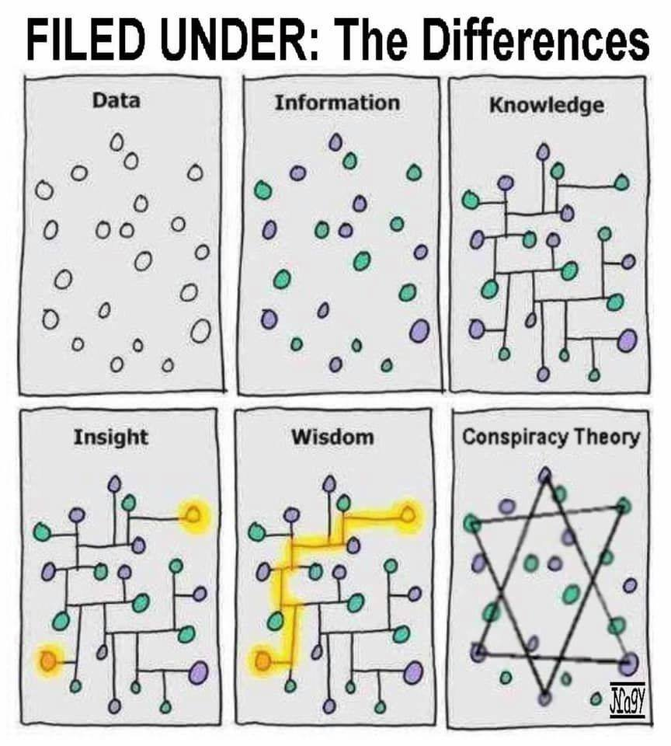
Differentiating : Data , Information, Knowledge, Insight and Wisdom, and... consipracy

Slide 14
Data visualization
Data visualization is a graphic representation that expresses the significance of data. It reveals insights and patterns that are not immediately visible in the raw data. It is an art through which information, numbers, and measurements can be made more understandable. According to (Friedman 2008):
The primary goal of data visualization is to communicate information clearly and effectively through graphical means. It does not mean that data visualization needs to look boring to be functional or extremely sophisticated to look beautiful. To convey ideas effectively, both aesthetic form and functionality need to go hand in hand, providing insights into a rather sparse and complex data set by communicating its key-aspects more intuitively.
https://mschermann.github.io/data_viz_reader/introduction.html#what-is-data-visualization

Slide 15
Why good data visualization is such a powerful tool?
Intuitive: Presenting a graph as a node-link structure instantly makes sense, even to people who have never worked with graphs before.
Fast: It is fast because our brains are great at identifying patterns, but only when data is presented in a tangible format. Armed with visualization, we can spot trends and outliers very effectively.
Flexible: The world is densely connected, so as long as there is an interesting relationship in your data somewhere, you will find value in graph visualization.
Insightful: Exploring graph data interactively allows users to gain more in-depth knowledge, understand the context and ask more questions, compared to static visualization or raw data

Slide 16
basic criteria that a data visualization should satisfy to be effective
Criteria | Description
Informative | The visualization should be able to convey the desired information from the data to the reader.
Efficient | The visualization should not be ambiguous.
Appealing | The visualization should be captivating and visually pleasing.
Interactive and Predictive (Optional) | The visualizations can contain variables and filters with which the users may interact to predict results of different scenarios.
Pittenturf, Chris. 2018. “What Is Data Visualization and Why Is It Important?” https://data-visualization.cioreview.com/cxoinsight/what-is-data-visualization-and-why-is-it-important-nid-11806-cid-163.html.

Slide 17
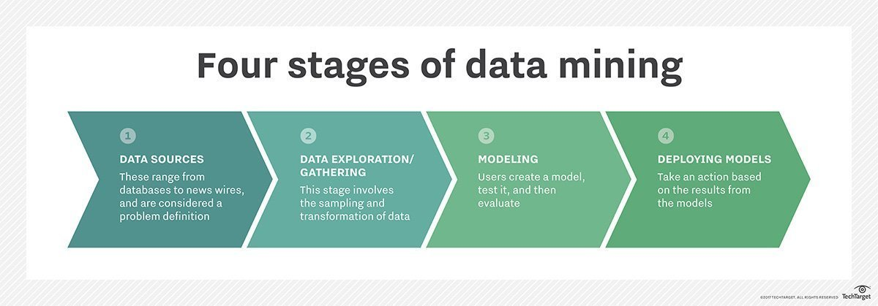
Data Exploration
for example, through scatter plots, density plots or bar charts – users can see if two or more variables correlate and determine if they are good candidates for further analysis, which may include:
Notes:
“Data exploration tasks are those of examining data without having an a priori understanding of what patterns, information, or knowledge it might contain.” (Jeff Baker 2009) While the majority of research has been on the output of and creation of visualizations, but the important aspect of these tasks is to first understand the data that is being presented.

Slide 18
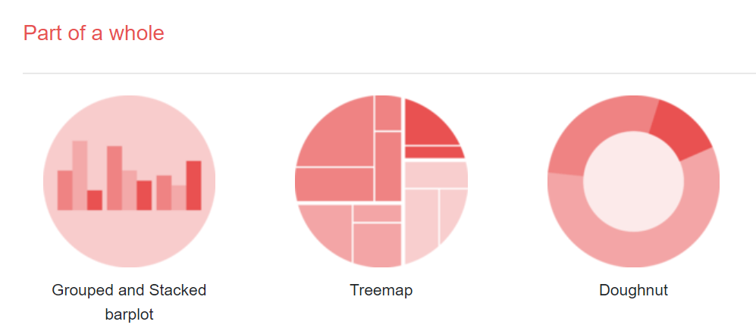
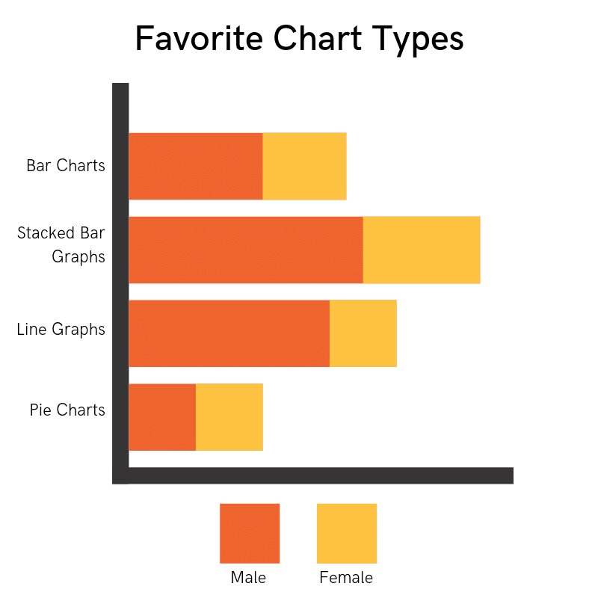
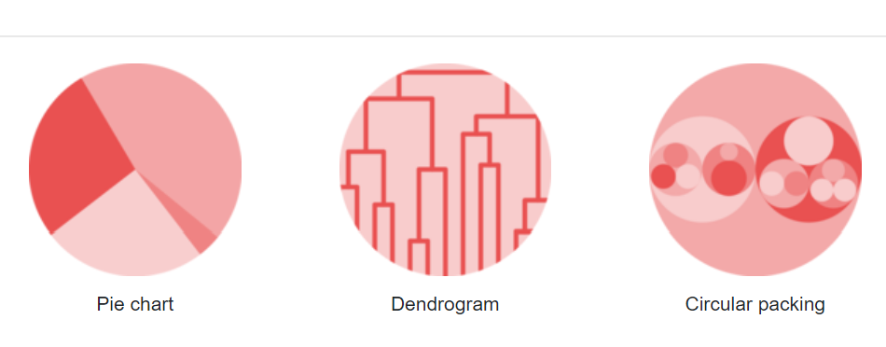
Nominal variable

Slide 19
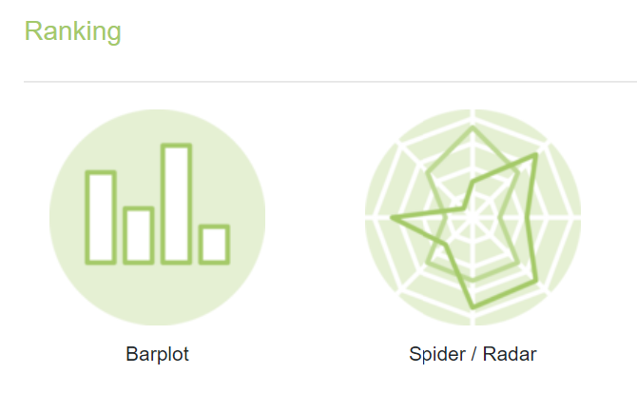
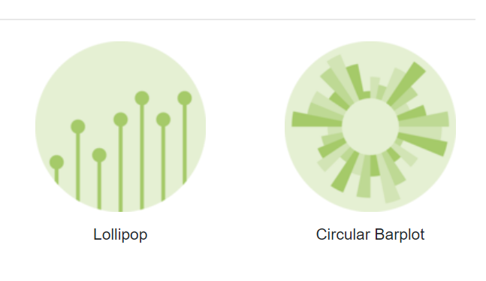
Ranking (both Nominal and ordinal)

Slide 20
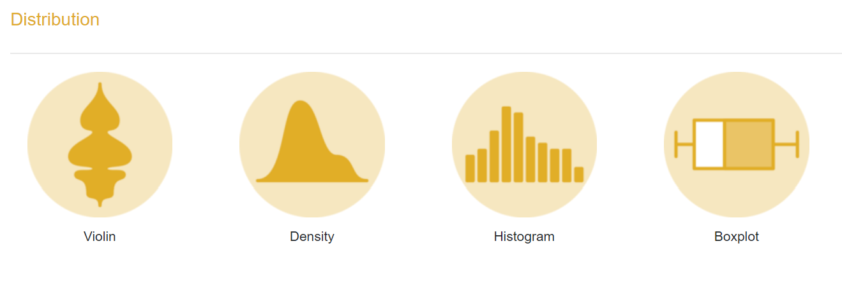
Interval/Ratio- univariate

Slide 21
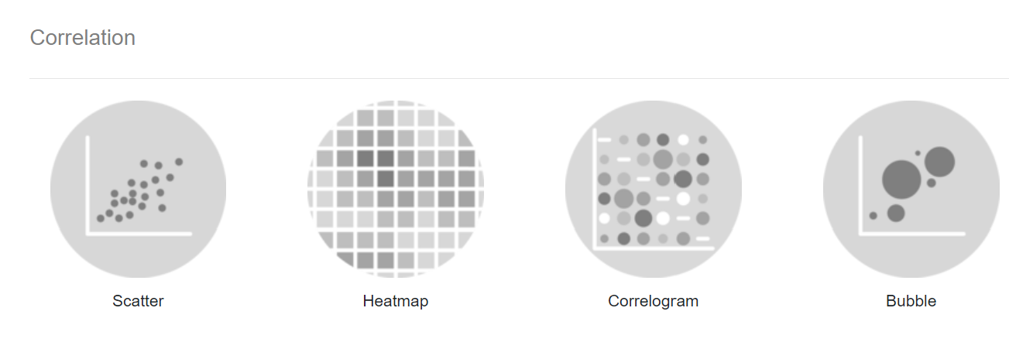
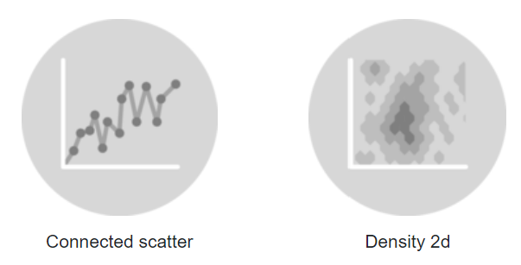
Ratio- bivariate

